Slide 1
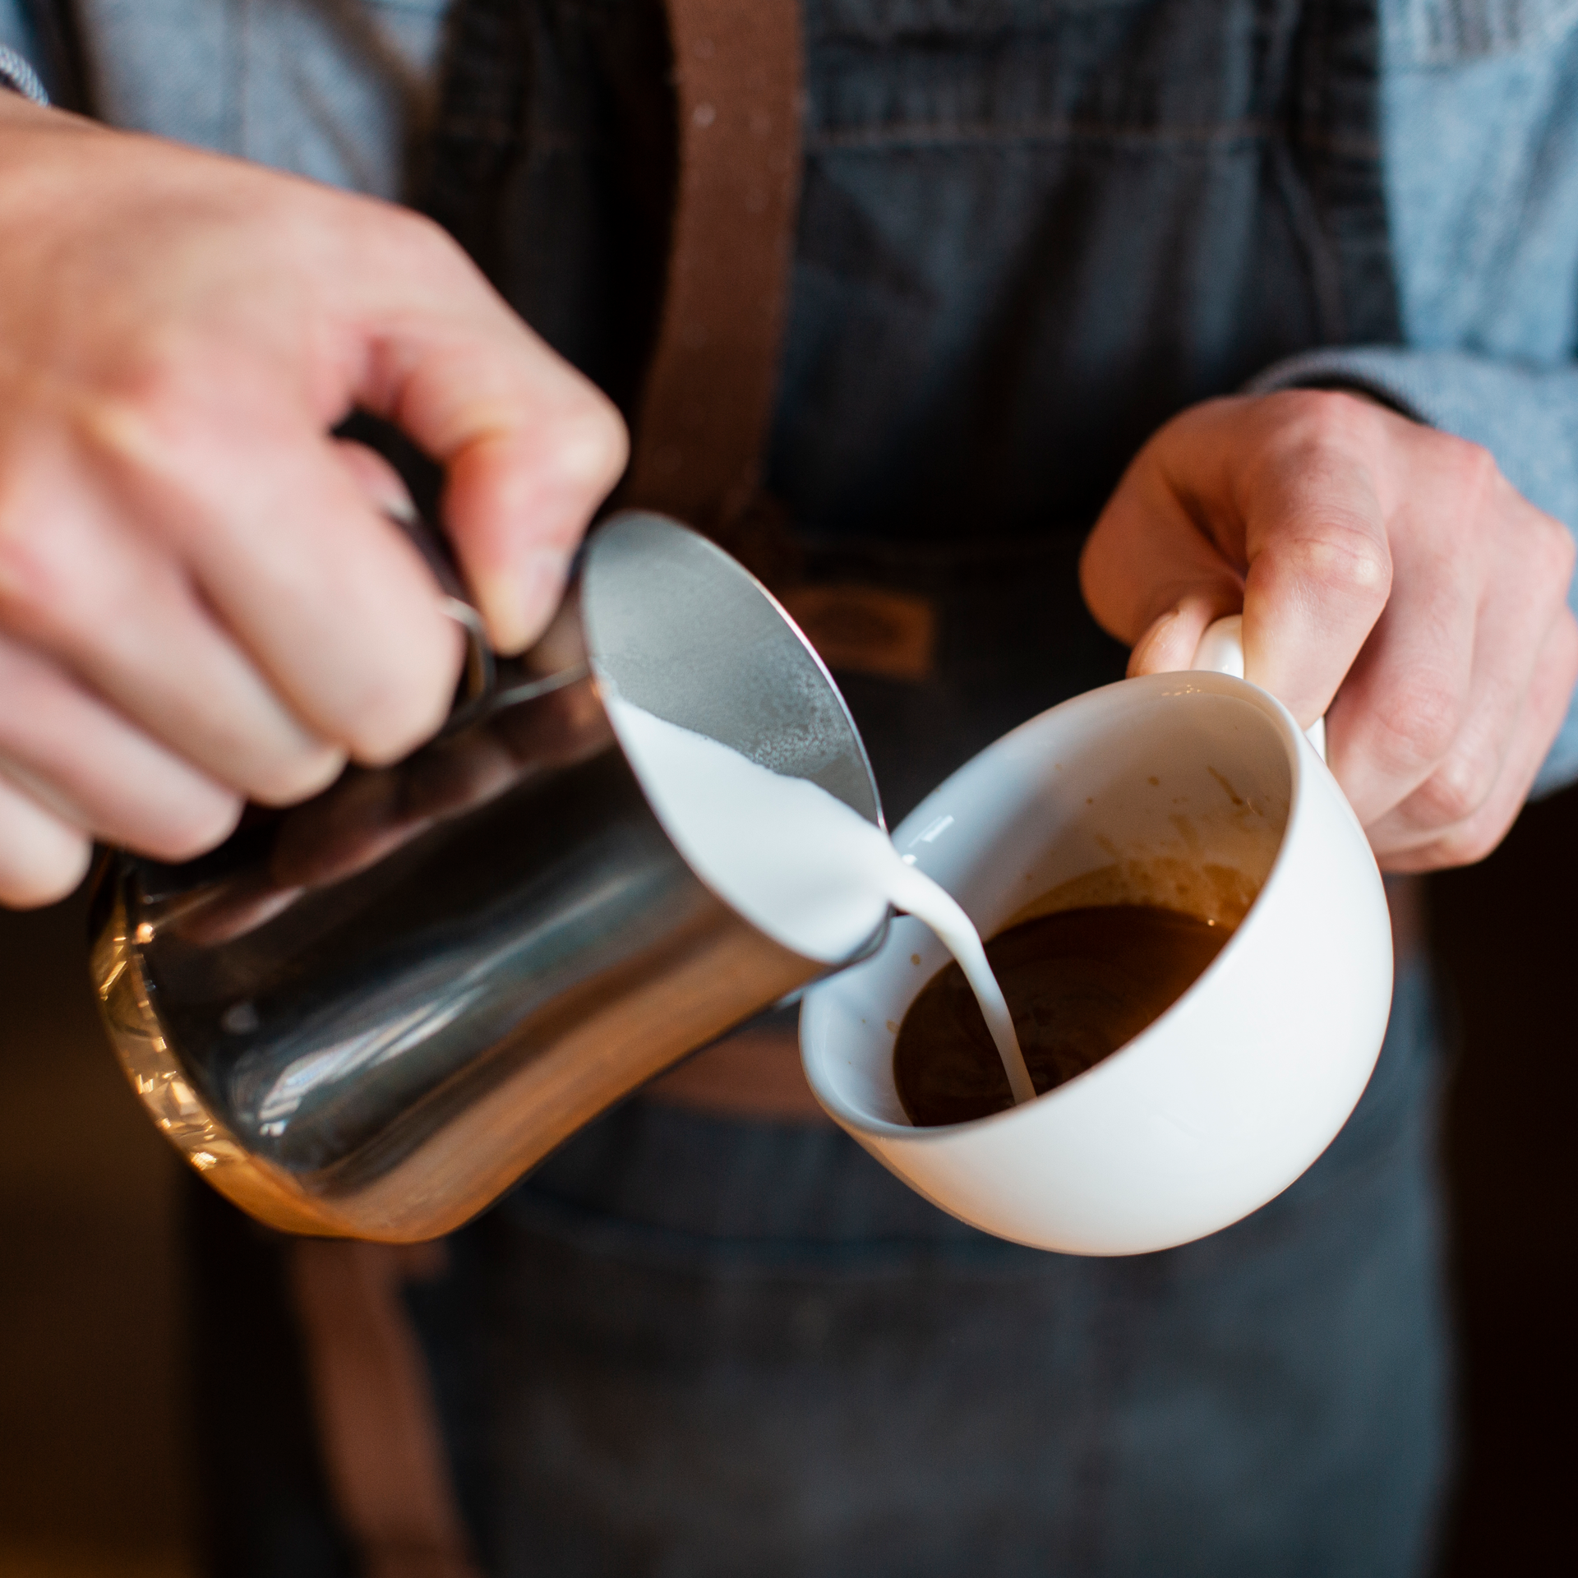


Slide 2

TABLE OF CONTENTS
01
02
03
04
Revenue |
Revenue |
By store location
Store Location & Time Buckets
Units sold |
Revenue |
Store Location & Time of Day
Store Location & Daily Trend

Slide 3
Revenue | Store Location
Revenue across all the stores increased by 50% in June comparing to Feb.
Coffee contributes 38% of the total revenue generated in the last 6 months while tea contributes 28% as 2nd best.

Slide 4
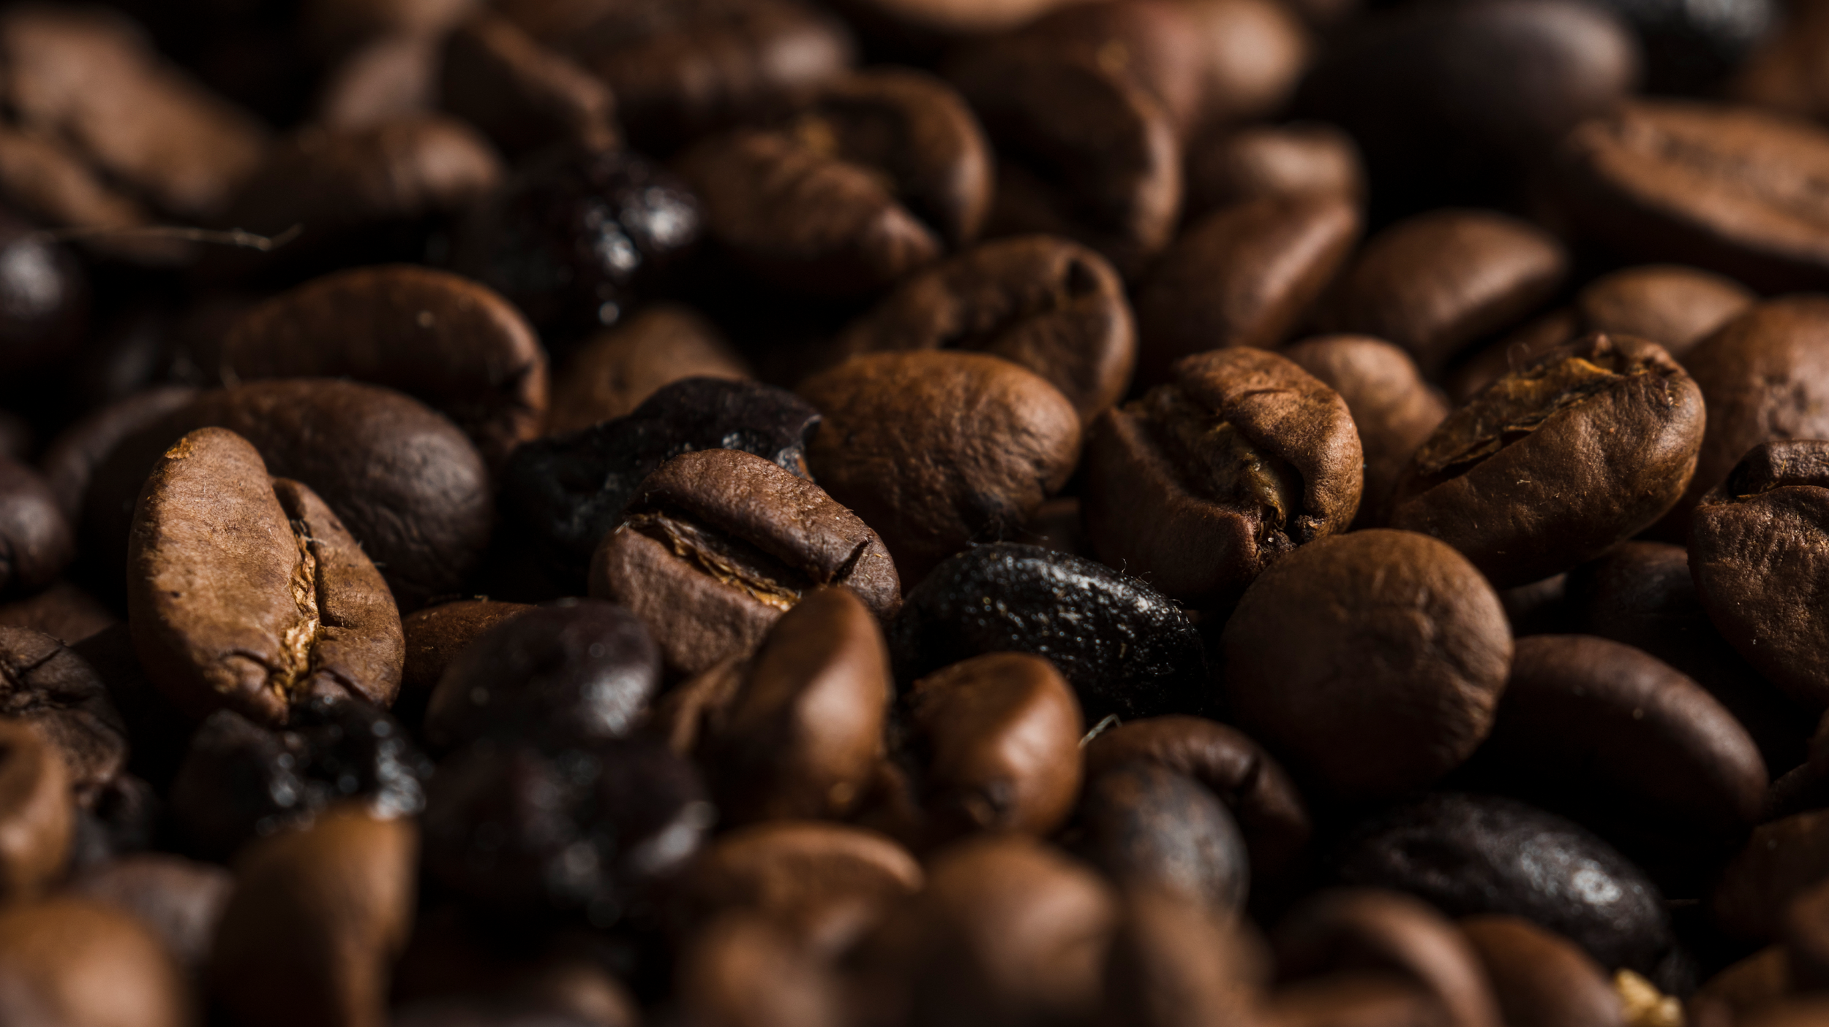
Revenue | Store Location & Time Buckets
CO
FF
EE
54% of the sales came in the morning across all the stores, while only 15% of the sales are generated in the evening.
Night sales only accounts for 0.4% of the total sales

Slide 5
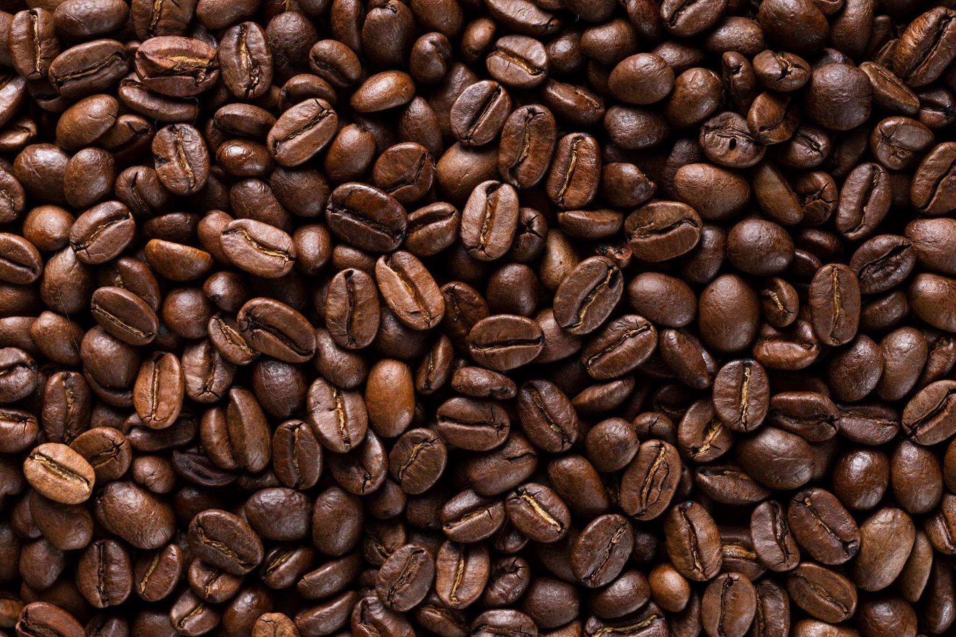
Units sold | Store Location & Time of Day
54% of the sales came in the morning across all the stores, while only 15% of the sales are generated in the evening.
Revenue is consistence across the shops between 12pm and 7pm
It is worth noting that creating price drop promotion at 10am can dilute the customer interest

Slide 6
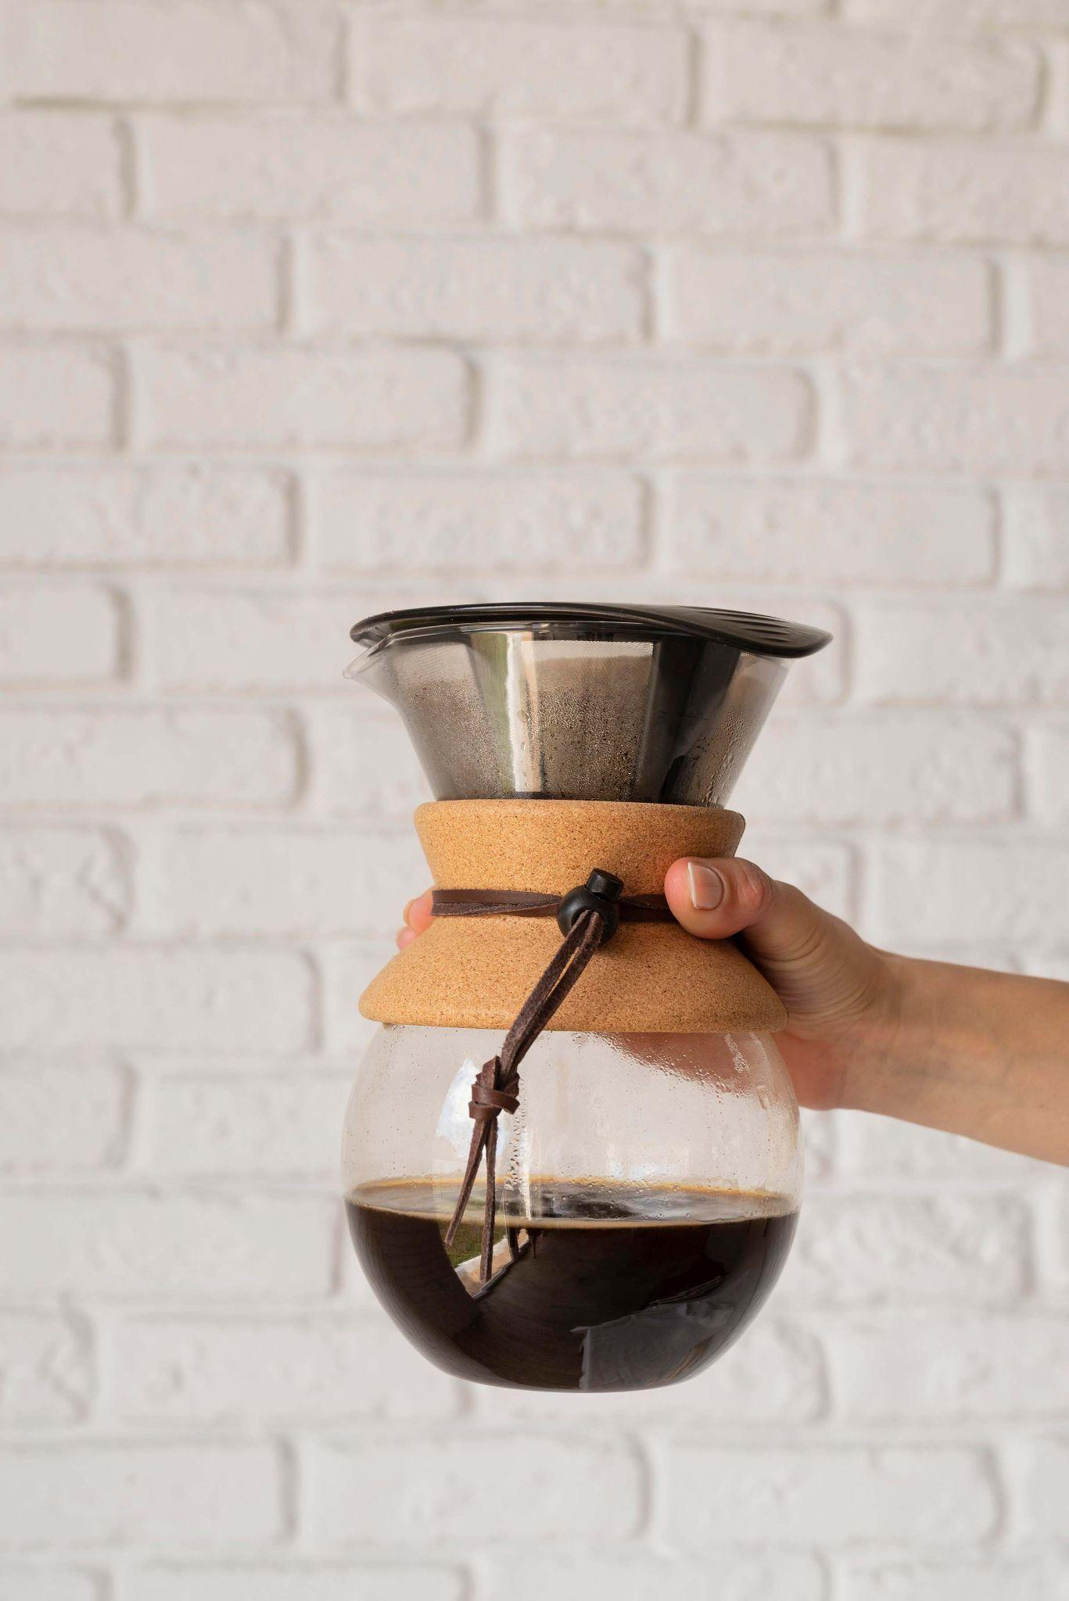
Units sold | Store Location & Daily Trend
Lower Manhattan shows strong revenue growth, while Astoria remains stable but lower-performing.

Slide 7
Recommendations
☕ Focus on Top Sellers
☀️ Strengthen Morning Strategy
Prioritize inventory and marketing for top-sellers (Sustainably Grown Organic, Latte, Cappuccino).
Promote these items across store menus, social media, and digital ads to leverage their proven popularity.
Continue focusing on the morning peak (7–11 AM) with loyalty rewards and express-service promotions.
Offer pre-order or subscription-based coffee programs to retain regular morning customers.
🕓 Boost Afternoon Sales
🥐 Promote Underperforming Items
Launch “Afternoon Happy Hour” campaigns between 2–4 PM to attract more customers during off-peak hours.
Introduce combo deals such as “Coffee + Pastry” or “Buy 2 Get 1 Free” to encourage higher basket sizes.
Highlight Bakery and Chocolate items through cross-selling with beverages.
Bundle slow-moving products with best-sellers to increase visibility and sales volume.

Slide 8
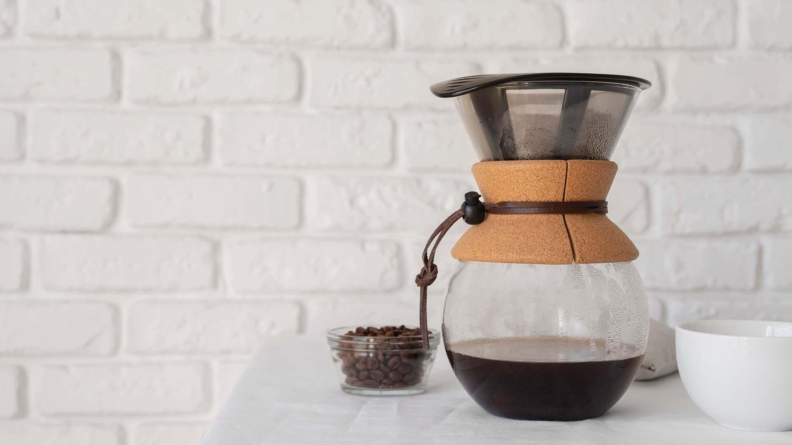
THANK YOU
Tshifhiwa Tshikosi

